Slide 1




Cyber Security Investigations with Jupyter Notebooks
Ian Hellen
Principal Software Development Engineer
Microsoft Threat Intelligence Center
@ianhellen @ianhelle

Slide 2

Jupyter Notebooks, InfoSec & MSTICPy
Overview
Background
Getting data
Enriching data
Visualizing threats
Putting it together
Looking at architecture and Python coding techniques we used to make our package

Slide 3
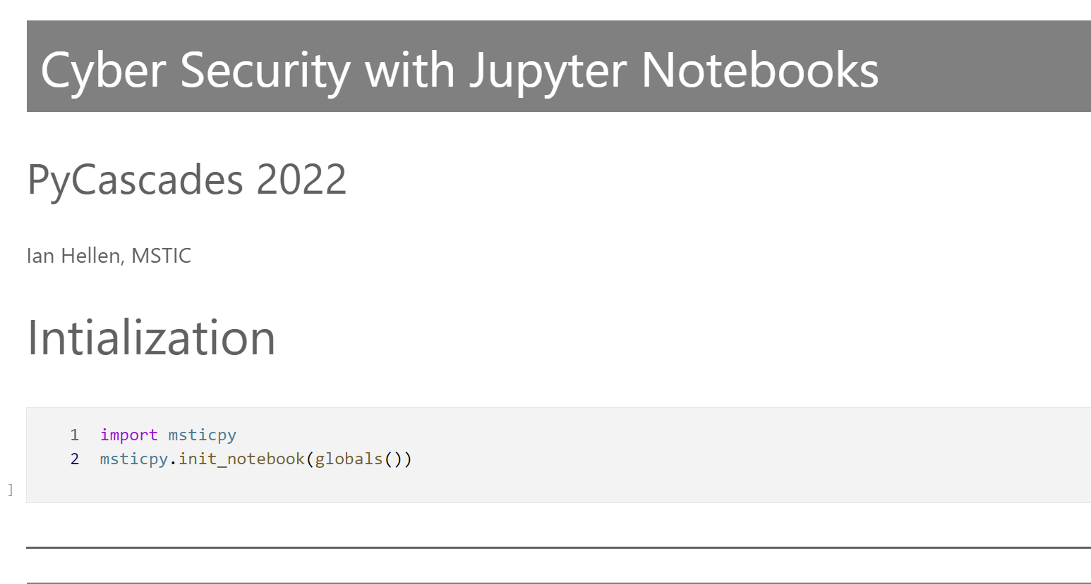
Companion notebook
https://github.com/ianhelle/pycascades2022

Slide 4
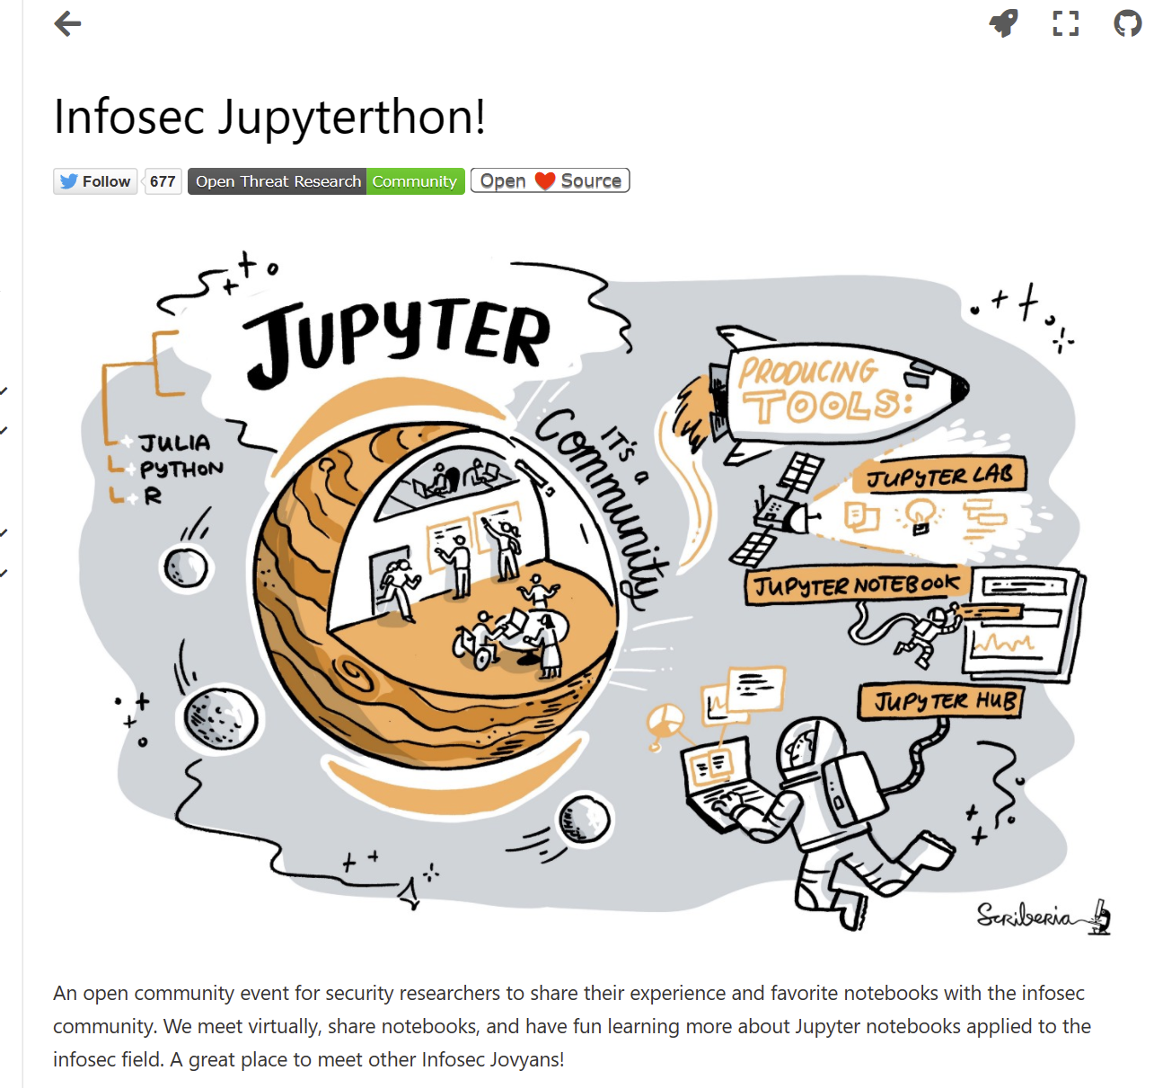
What is great about Jupyter for Infosec?
Python/Jupyter ecosystem
Accessible technology – open source
Packages – pandas, requests, bokeh…
Python!
Jupyter-specific
Break out of proprietary SOC tools constraints
Control your own workflow
Visualizations
Analysis
NB Format
Blend text/code/visualization
Auto-saving progress
Shareable document format
Re-use of notebooks
https://infosecjupyterthon.com

Slide 5
Where there are
InfoSec Analyst
Many Jupyter and Python features shaped by origins in Scientific and Data Science worlds
I want to break us out of the proprietary world of SIEMs but Jupyter/Python seems hard
Viz
Bar/line charts not too useful
Data
Domain-specific visualizations
Many log sources
Template queries
Analytics
Data is predominantly text (not numbers)
Consistent access pattern
Specialized data - TI
gaps
opportunities
High bar
Learning curve
Coding
Example notebooks
SIEM: Security Information and Event Management https://en.wikipedia.org/wiki/Security_information_and_event_management

Slide 6

MSTICPy
A toolset for cyber security investigators/hunters
Open source
Jupyter notebooks but also Python apps and scripts
Main components:
Data access & queries
Enrichment
Visualizations
Analysis
MSTICPy GitHub https://github.com/microsoft/msticpy
MSTICPy Docs
https://msticpy.readthedocs.io

Slide 7

Data Providers (Config-driven func creation)
Without big data, you are blind and deaf and in the middle of a freeway.
Geoffrey Moore
In God we trust, all others bring data.
W Edwards Deming

Slide 8
Data providers
Analysts need lots of data, often from lots of different places
Extensible data provider drivers masking:
Different access methods
Different query languages
Different authentication requirements
Parameterized queries
Returns pandas DataFrame
Our solution
Based on Intake - https://intake.readthedocs.io
qp = QueryProvider(driver_name)
qp.connect(connection_string)
qp.list_queries()
# run a query
qp.query_name(params…)
Drivers: MSSentinel, MSDefender,
Splunk, MSGraph, Sumologic, OTRFData,
LocalData, …

Slide 9
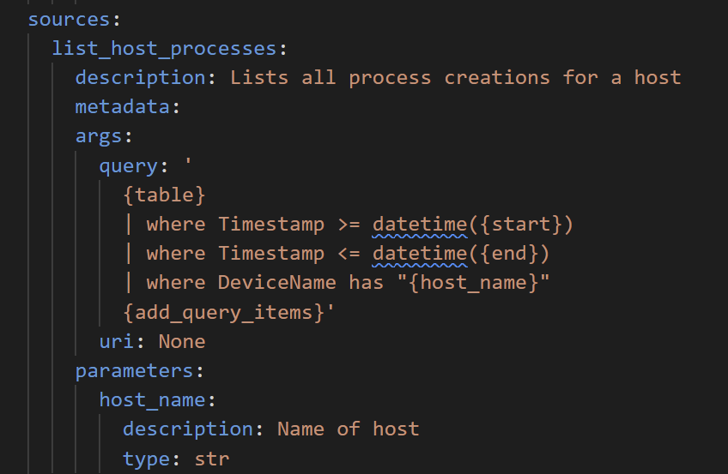
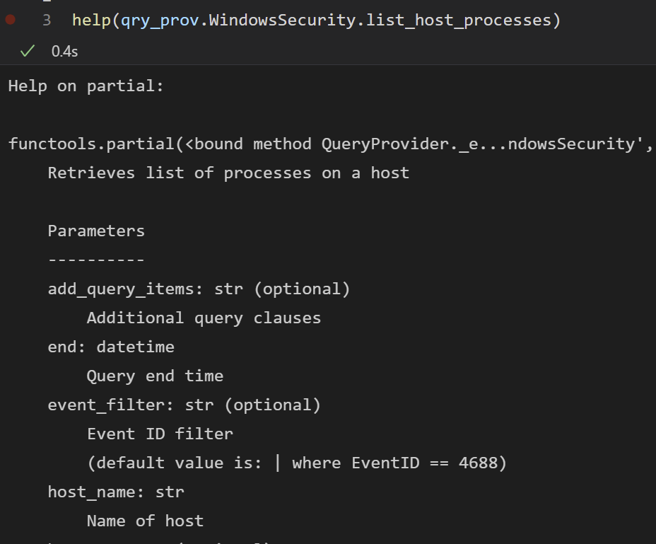
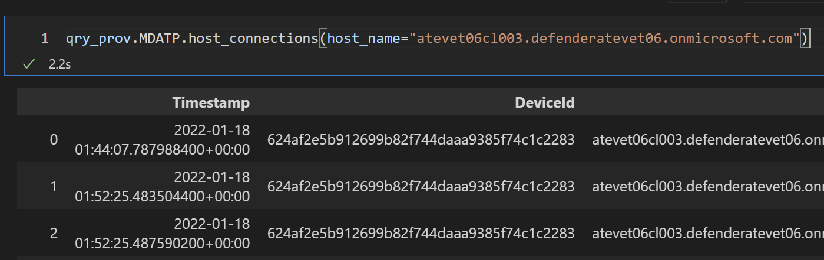
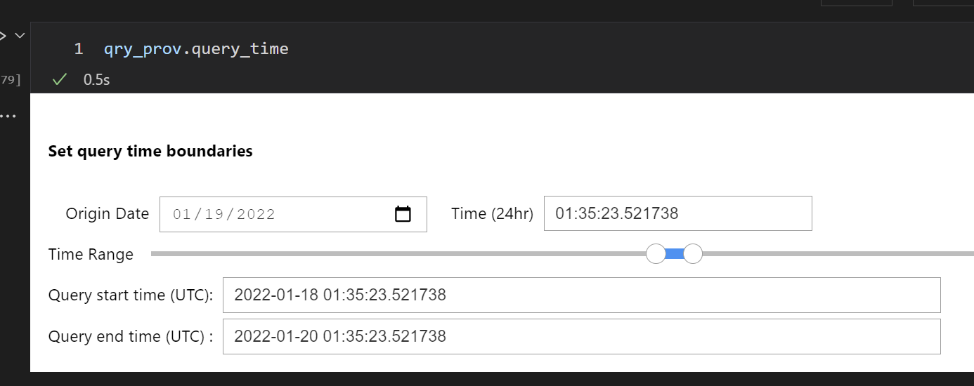
Data providers requirements
Built-in queries - declarative (YAML)
Invoke as Python functions
Informative doc strings
Query time management

Slide 10
Demo Config-driven functions

Slide 11

Enrichment (wrapping functions)
For me context is the key - from that comes the understanding of everything.
Kenneth Noland

Slide 12
Entities and context examples
IP Address
Who owns it?
What is the geographical location?
Threat intelligence reports identifying it as malicious
Is it ours?
Account
When did last log on?
Where did it log on?
Is there any suspicious activity associated with the account?
What does it have access to
Host
Domain
URL
File
App
---?
---?
---?
---?
---?
---?
---?
---?
---?
---?
---?
---?
---?
---?
---?
---?
---?
---?
---?
---?

Slide 13

Ideal enrichment functions
InfoSec analysts need a variety of contextual (enrichment) information
Check-list
Contextual data is specific to each “entity”
Needs to be easy to discover contextual data methods
They should work in (roughly) the same way
Common parameters
Common return types

Slide 14


Our initial approach
We built a bunch of enrichment functions:
Geo-location of IPs
Domain/IP ownership
Threat intelligence
others
Some extensible – so some consistency.
Fails
No special association between the enrichment function and what you wanted to enrich
You had to know what to import from where
Every provider interface was a little bit different:
input parameters
Names
Types
output format
Check-list
Specific to each “entity”
Needs to be easy to discover
Should work in the same way

Slide 15
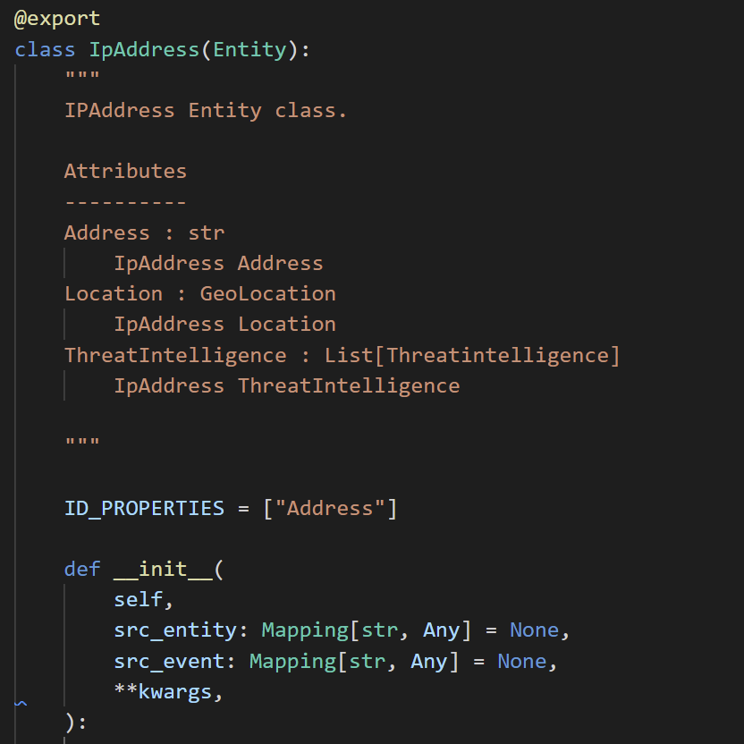
Entity-centric pivot functions
Example entities
Account | Alert | AzureResource | CloudApplication
Dns | File | Host | IoTDevice
IpAddress | Mailbox | Malware | NetworkConnection
Process | RegistryKey | RegistryValue | Url
But we’d already written the enrichment code
Wrap enrichment functions for consistent interface
Dynamically attach to entities

Slide 16
Demo Pivot mechanism

Slide 17

Visualization
A soul never thinks without a picture
Aristotle

Slide 18
Visualization Requirements
InfoSec analysts need a domain-specific visualizations.
Criteria
Time-based charts are critical
Some specific visualization types:
Process trees
Graphs
Interactivity
zooming, hover for more info
Discoverability

Slide 19
Visualization in MSTICPy
No silver bullet – fair bit of coding
Standardized on Bokeh
Support generic input
Only need a timestamp
Pandas accessors
Visualizations
Event timeline
Event duration
Matrix (interaction)
Time series
Process tree
Inspirations & Credits
Bokeh Periodic table
https://docs.bokeh.org/en/latest/docs/gallery/periodic.html
Myrthings – CatScatter
https://github.com/myrthings/catscatter

Slide 20
Demo Visualization

Slide 21

Compos-ability
Everything should work together!
Ideally one function output can be the input for another
Chained pipelines for repeatable analysis

Slide 22
Standing on the shoulders of giant (pandas)
Make everything pandas-centric
Functions should always accept DataFrames as input
Return DataFrame by default
Use pandas accessors
Inspirations
Pandas https://pandas.pydata.org/docs/development/extending.html
Hvplot (and others) https://hvplot.holoviz.org/

Slide 23
Demo Composable functions

Slide 24

Conclusion
What seems like a quick project can grow on you!
Organic growth is not always organized growth
Understand the special requirements of your domain
Plan for:
Discoverable functionality
Consistent experience (inputs/outputs)
Building the right visualizations
Python lets you bend the very laws of space and time!

Slide 25
References
What | Where
The notebook | https://github.com/ianhelle/pycascades2022
MSTICPy GitHub repo | https://github.com/microsoft/msticpy (leave us a star if you like it!)
MSTICPy Docs | https://msticpy.readthedocs.io
Simple feature notebooks | https://github.com/microsoft/msticpy/tree/main/docs/notebooks
Scenario notebooks | https://github.com/Azure/Azure-Sentinel-Notebooks
Contact | @ianhellen @ianhelle @msticpy msticpy@microsoft.com

